Slide 1

MERN Stack Powered By Mongodb
Freelance Application Using MERN Stack
Praveena G - 311121205045
Hemasree K - 311121205302
Swetha S - 311121205057
Vijaysasan M - 311121205701

Slide 2
Problem Statement
Difficulty finding the right freelancer or client for specific needs.
Trust issues with unclear payment terms, delays, and disputes.
Inadequate tools for communication, task tracking, and workflow management.
High commissions reduce freelancer earnings.
Complexities in cross-border payments and currency conversion.

Slide 3
Solution Proposed
AI-driven recommendations based on skills, ratings, and preferences.
Escrow integration for secure and transparent payments.
Task assignments, real-time chat, milestone tracking, and file sharing.
Subscription model or reduced commissions for affordability.
Multi-currency support and international payment gateway integrations.

Slide 4
Technical Implementation (MERN Stack)
Technical Implementation (MERN Stack)
Frontend (React.js):
User-friendly interface with responsive design for web and mobile.
Dashboards for freelancers and clients.
Real-time notifications and messaging.
Backend (Node.js + Express.js):
RESTful APIs for data handling.
Secure authentication (JWT).
Payment gateway integrations (PayPal, Stripe, etc.).
Database (MongoDB):
Flexible and scalable schema for user profiles, projects, and transactions.

Slide 5


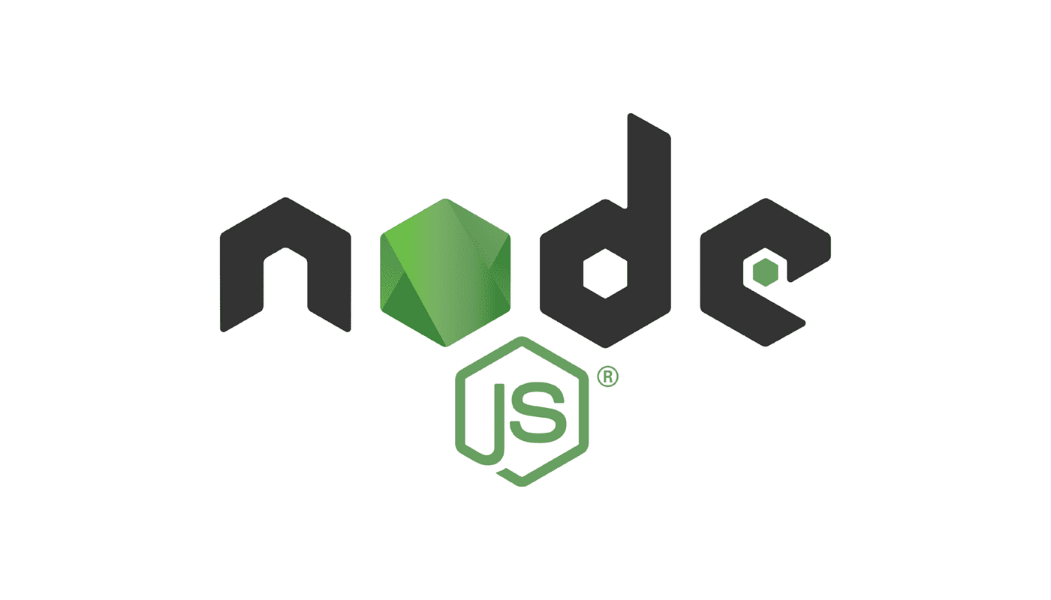

Technology Stack
MERN Stack:
MongoDB: NoSQL database for storing and managing book records.
Express.js: Backend framework for building RESTful APIs and handling server-side logic.
React : Frontend library for creating an interactive user interface, using Vite as a fast development build tool.
Node.js: JavaScript runtime for running server-side applications.

Slide 6
Reason For Choosing These Technologies
MongoDB:
A NoSQL database that stores data in flexible, JSON-like documents.
Provides high scalability and supports unstructured or semi-structured data.
Express.js:
A lightweight web framework for Node.js used to build the backend of applications.
Simplifies handling HTTP requests, routing, and middleware.
React.js:
A JavaScript library for building user interfaces, particularly single-page applications (SPAs).
Uses a component-based architecture and Virtual DOM for high performance.
Node.js:
A JavaScript runtime environment that allows developers to execute JavaScript code on the server side.
Known for its non-blocking, event-driven architecture, making it efficient and scalable.

Slide 7
Benefits
Simplified user experience for both clients and freelancers.
Transparent workflows and secure payment processes.
Scalable architecture for platform growth.
Cost-effective platform with reduced fees.
Easy international accessibility with robust payment solutions.

Slide 8

Demo Video
hhh

Slide 9
THANK YOU

